Slide 1





Home
Assignment
Step 5
Presented by: Group B

Slide 2





Overview
Roadmap
The Data
Classification
Regression
Cascading
Note potential issues
Risk Assesment

Slide 3







ROAD MAP
WEEK 0-2
WEEK 2-4
WEEK 4-6
WEEK 6-8
WEEK 8-10
WEEK 10-12
Business Understanding
Data Understanding/Data Preparation
Data Preparation/Modeling
Model selection and setup
Modeling/Evaluation
Evaluation/Deployment

Slide 4
Overview
Roadmap
The Data
Classification
Regression
Cascading
Note potential issues
Risk Assesment

Slide 5






Recap Data Available
Number of instances
Features
snap 2018
snap 2019
Number of instances
Features
-30.4%
expired_2019

Slide 6
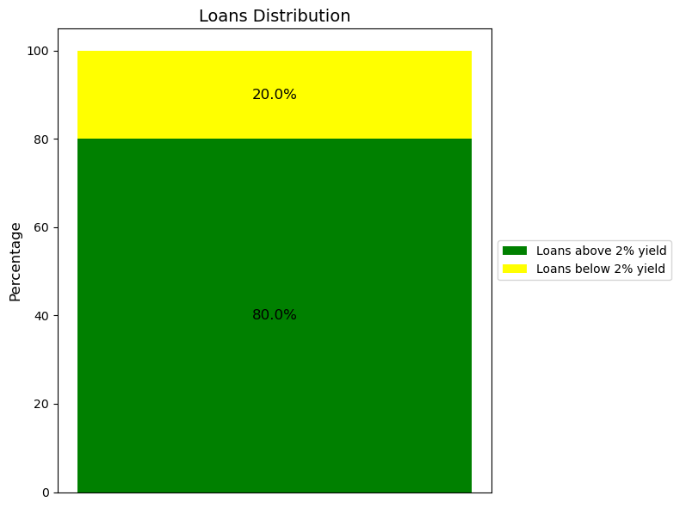
The Data
Features: 62
Instances: 322,980
loan yield above/under 2%

Slide 7
Overview
Roadmap
The Data
Classification
Regression
Cascading
Note potential issues
Risk Assesment

Slide 8
Model Selection
1. Binary Variable:
Above 2% yield
Classification
2. Continuous Variable: Expected Return- each loan
Regression

Slide 9
Classification
Models: Logistic Regression, XGBoost
Feature Selection:
Sequential feature selection

Slide 10
Classification
Hyperparameter Tuning: grid search & cross-validation
(weighted F1 score)
Skewness Handling:
Inverse proportional weighting
Threshold Tuning: Minimize FN & Maximize TN
(naive requirement- at least 50,000 instances classified as True Negatives)

Slide 11
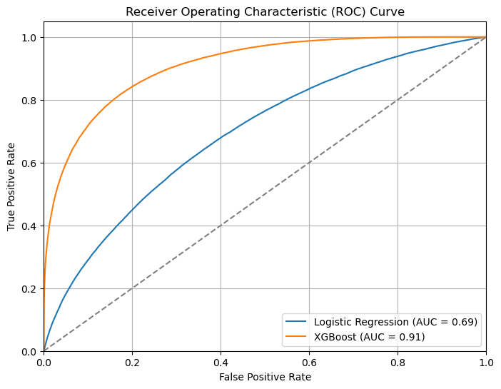


Classification Models

Slide 12
Overview
Roadmap
The Data
Classification
Cascading
Note potential issues
Risk Assesment

Slide 13
Model Selection
1. Binary Variable:
Above 2% yield
Classification
2. Continuous Variable: Expected Return- each loan
Regression

Slide 14
Overview
Roadmap
The Data
Classification
Cascading
Note potential issues
Risk Assesment

Slide 15
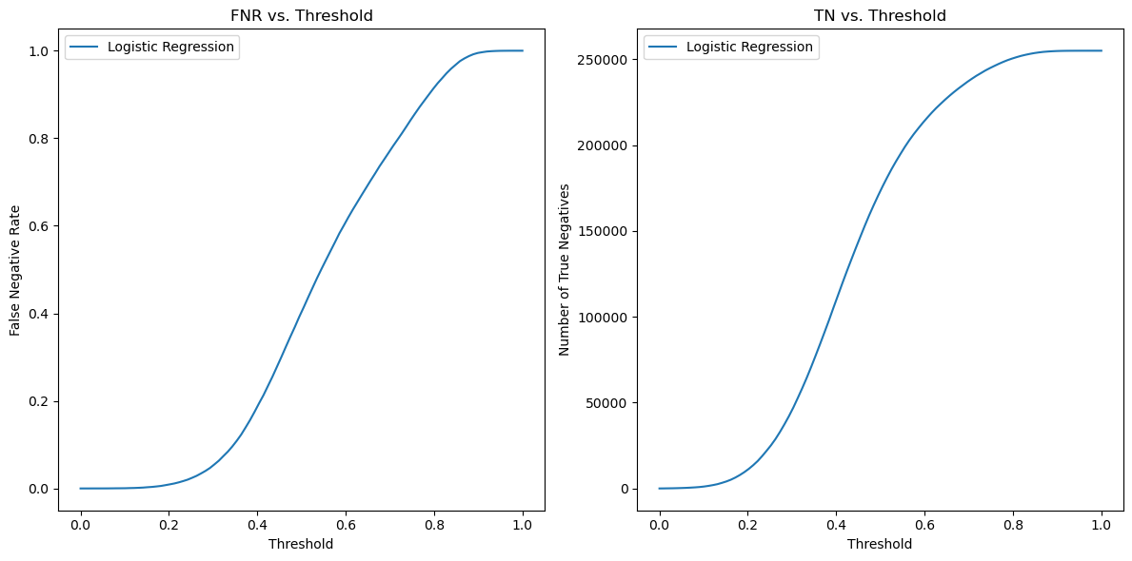
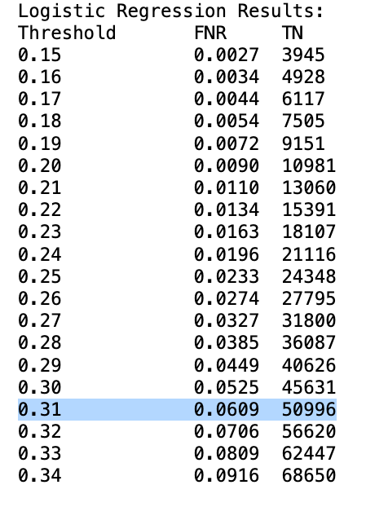
Picking the Treshold

Slide 16

Cascading
Logistic Regression -> Linear Regression
Logistic Regression -> Random Forest Regression
XGBoost -> Linear Regression
XGBoost -> Random Forest Regression
expected return of the loans that yield more than 2%

Slide 17
Benchmark models
Grade-Based Baseline Model:
loans in Grade A
regression application
Simple Benchmark Model:
Filtered loans- above 2% (by XGBoost)
Average expected return

Slide 18
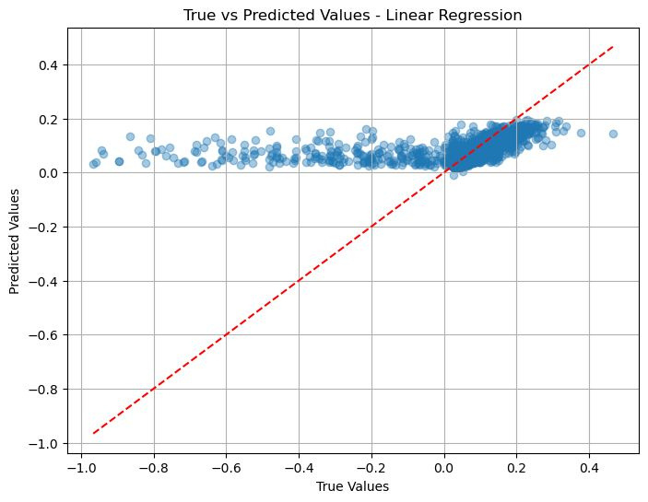
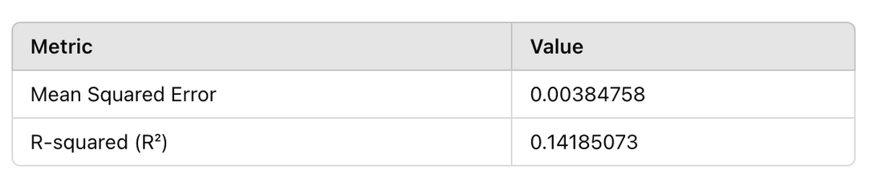
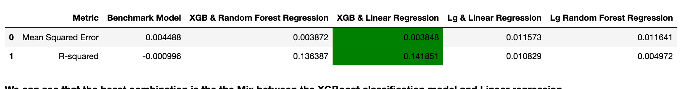
Best Model
XGBoost -> Linear Regression

Slide 19
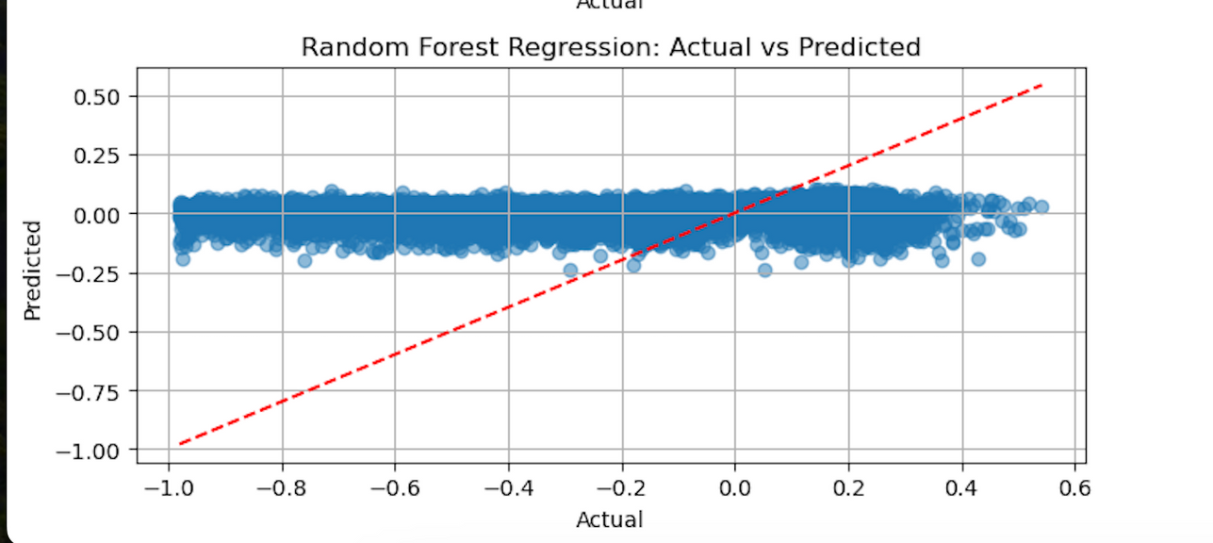

Model Evaluation
Linear Regression from Prior Step
XGboost -> Linear Regression
73.4% Improvement on MSE Compared to Random Forest Regrssion without Cascading.

Slide 20
Overview
Roadmap
The Data
Classification
Regression
Model Performence
Note potential issues
Risk Assesment

Slide 21
Pitfalls
Sequential Model Bias
Dependence on Initial Estimates
Absence of Risk Assessment

Slide 22
Overview
Roadmap
The Data
Classification
Regression
Cascading
Note potential issues
Risk Assesment

Slide 23
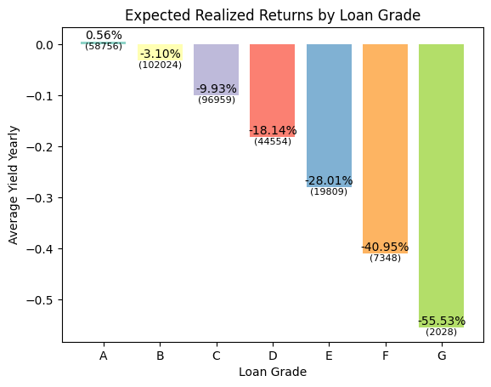
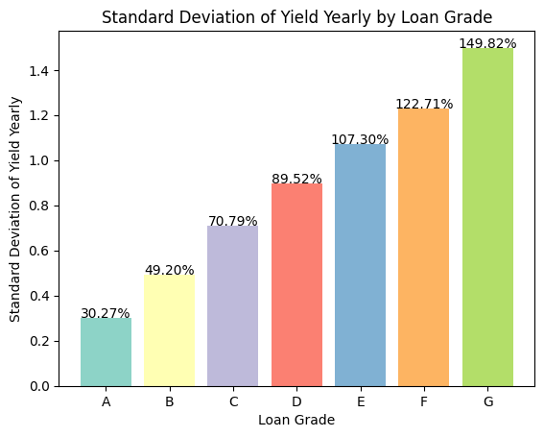
Next Level-Risk Assesment
}
H0 - Chosen loans’ average is lower than 2%
H1 - Chosen loans’ average is higher than 2%
confidence interval
analysis

Slide 24


GRADES MODEL & RISK ASSESMENT
COMING UP NEXT.....
FINANCIAL ANALYSIS
Step 6- Evaluation/Deployment
BUSINESS PERSPECTIVE

Slide 25


Thank you :)

